Slide 1
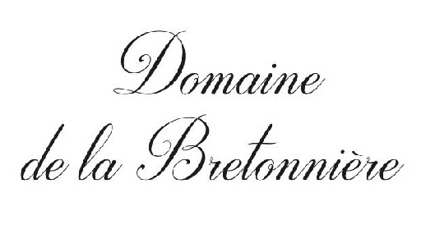

Slide 2
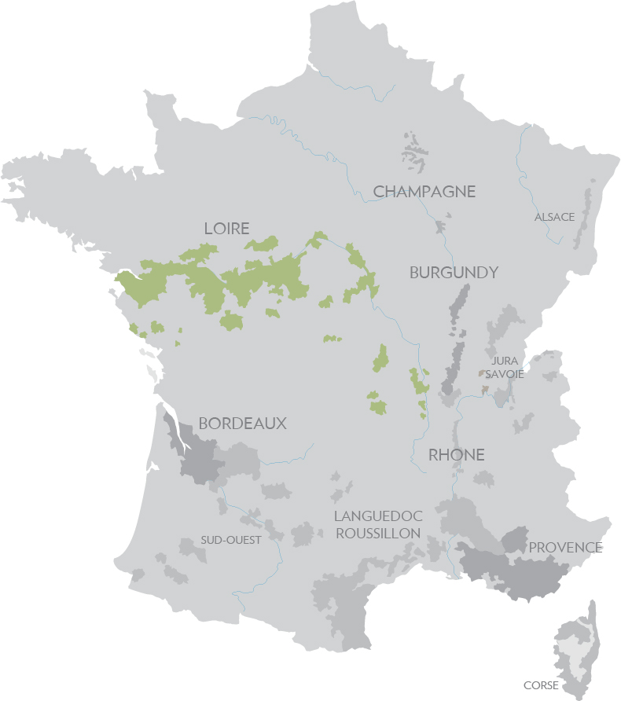
LOIRE

Slide 3
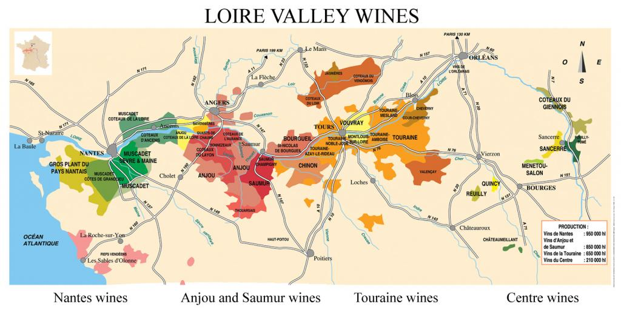

Slide 4
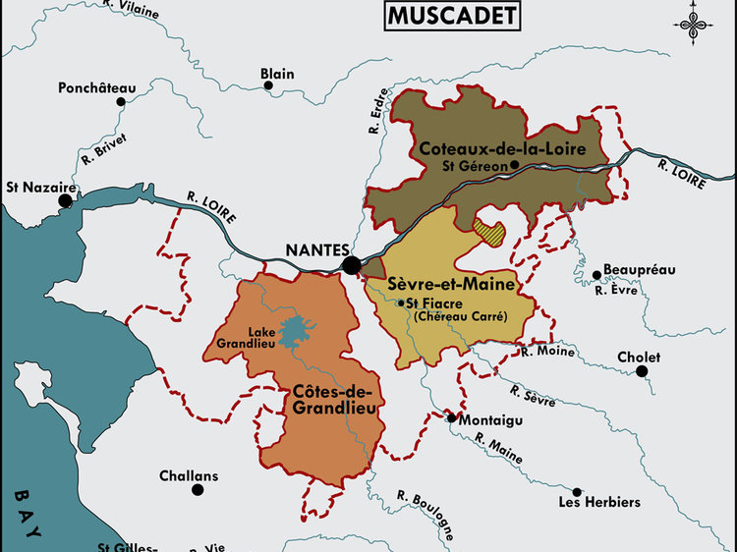

Slide 5
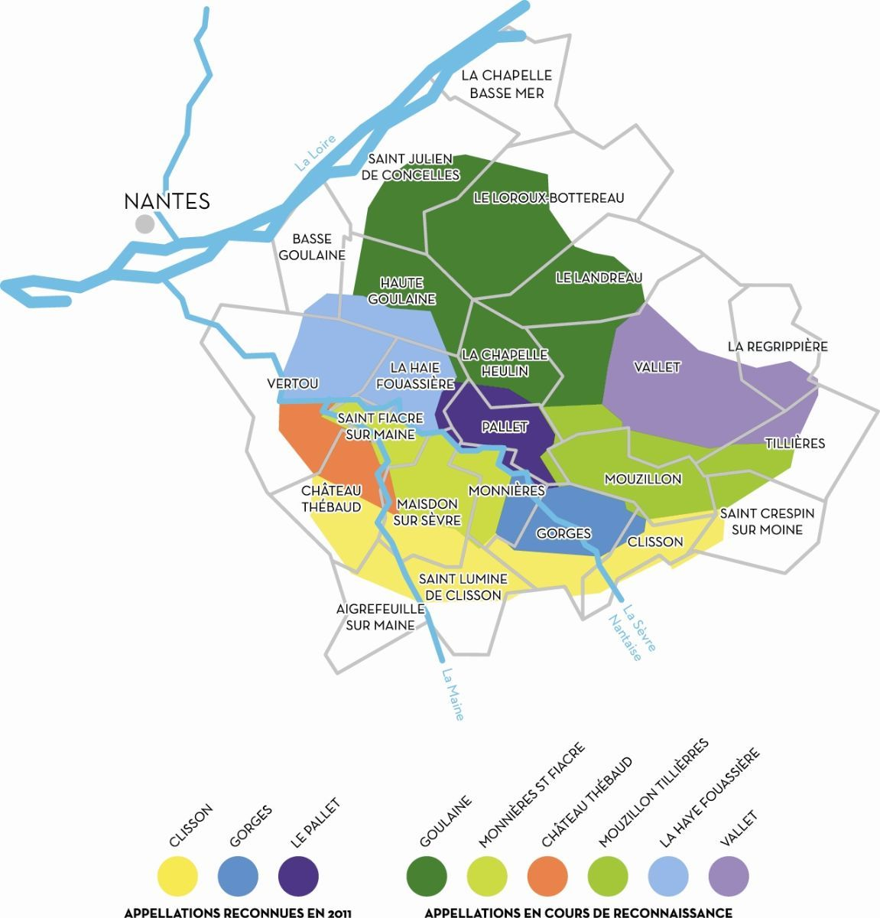
MUSCADET
SÈVRE-ET-MAINE

Slide 6
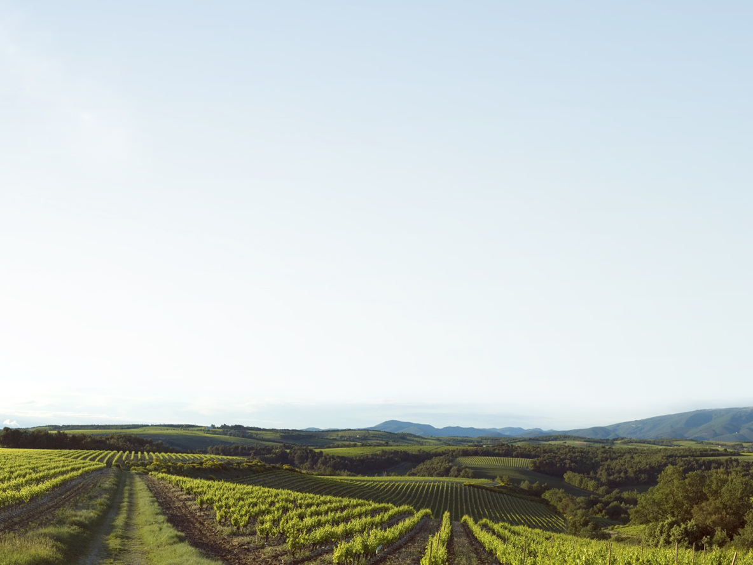
AOC MUSCADET
SÈVRE-ET-MAINE
Unlike other Appellation d'origine contrôlée wines, Muscadet is not named for its growing region or variety (as in Alsace).
The name comes from the phrase vin qui a un goût musqué - 'wine with a musk-like taste.’

Slide 7
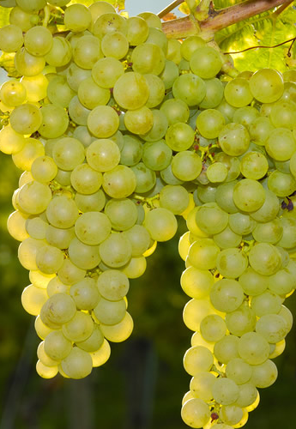
MELON DE BOURGOGNE
As its name suggests, Melon’s origin is Burgundian - one of the many progeny of Pinot and Gouais Blanc.
Melon was outlawed from Burgundy just like Gamay at various times during the 16th and 17th centuries.
Resistant to the cold and produces quite regularly and generously.

Slide 8
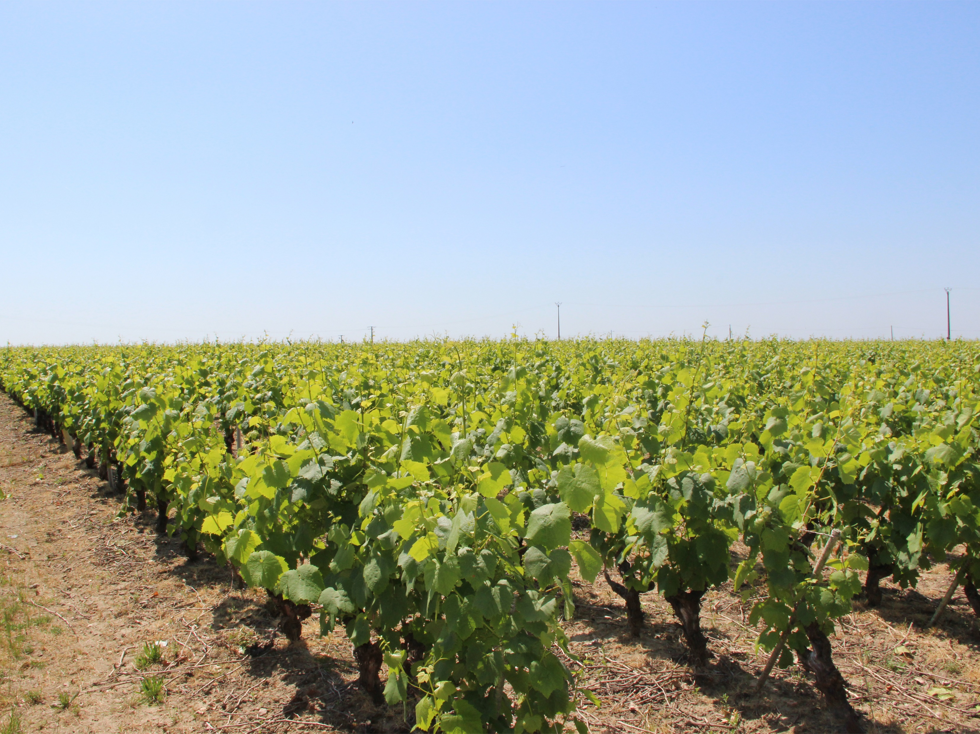
BretonniÈre vineyards

Slide 9
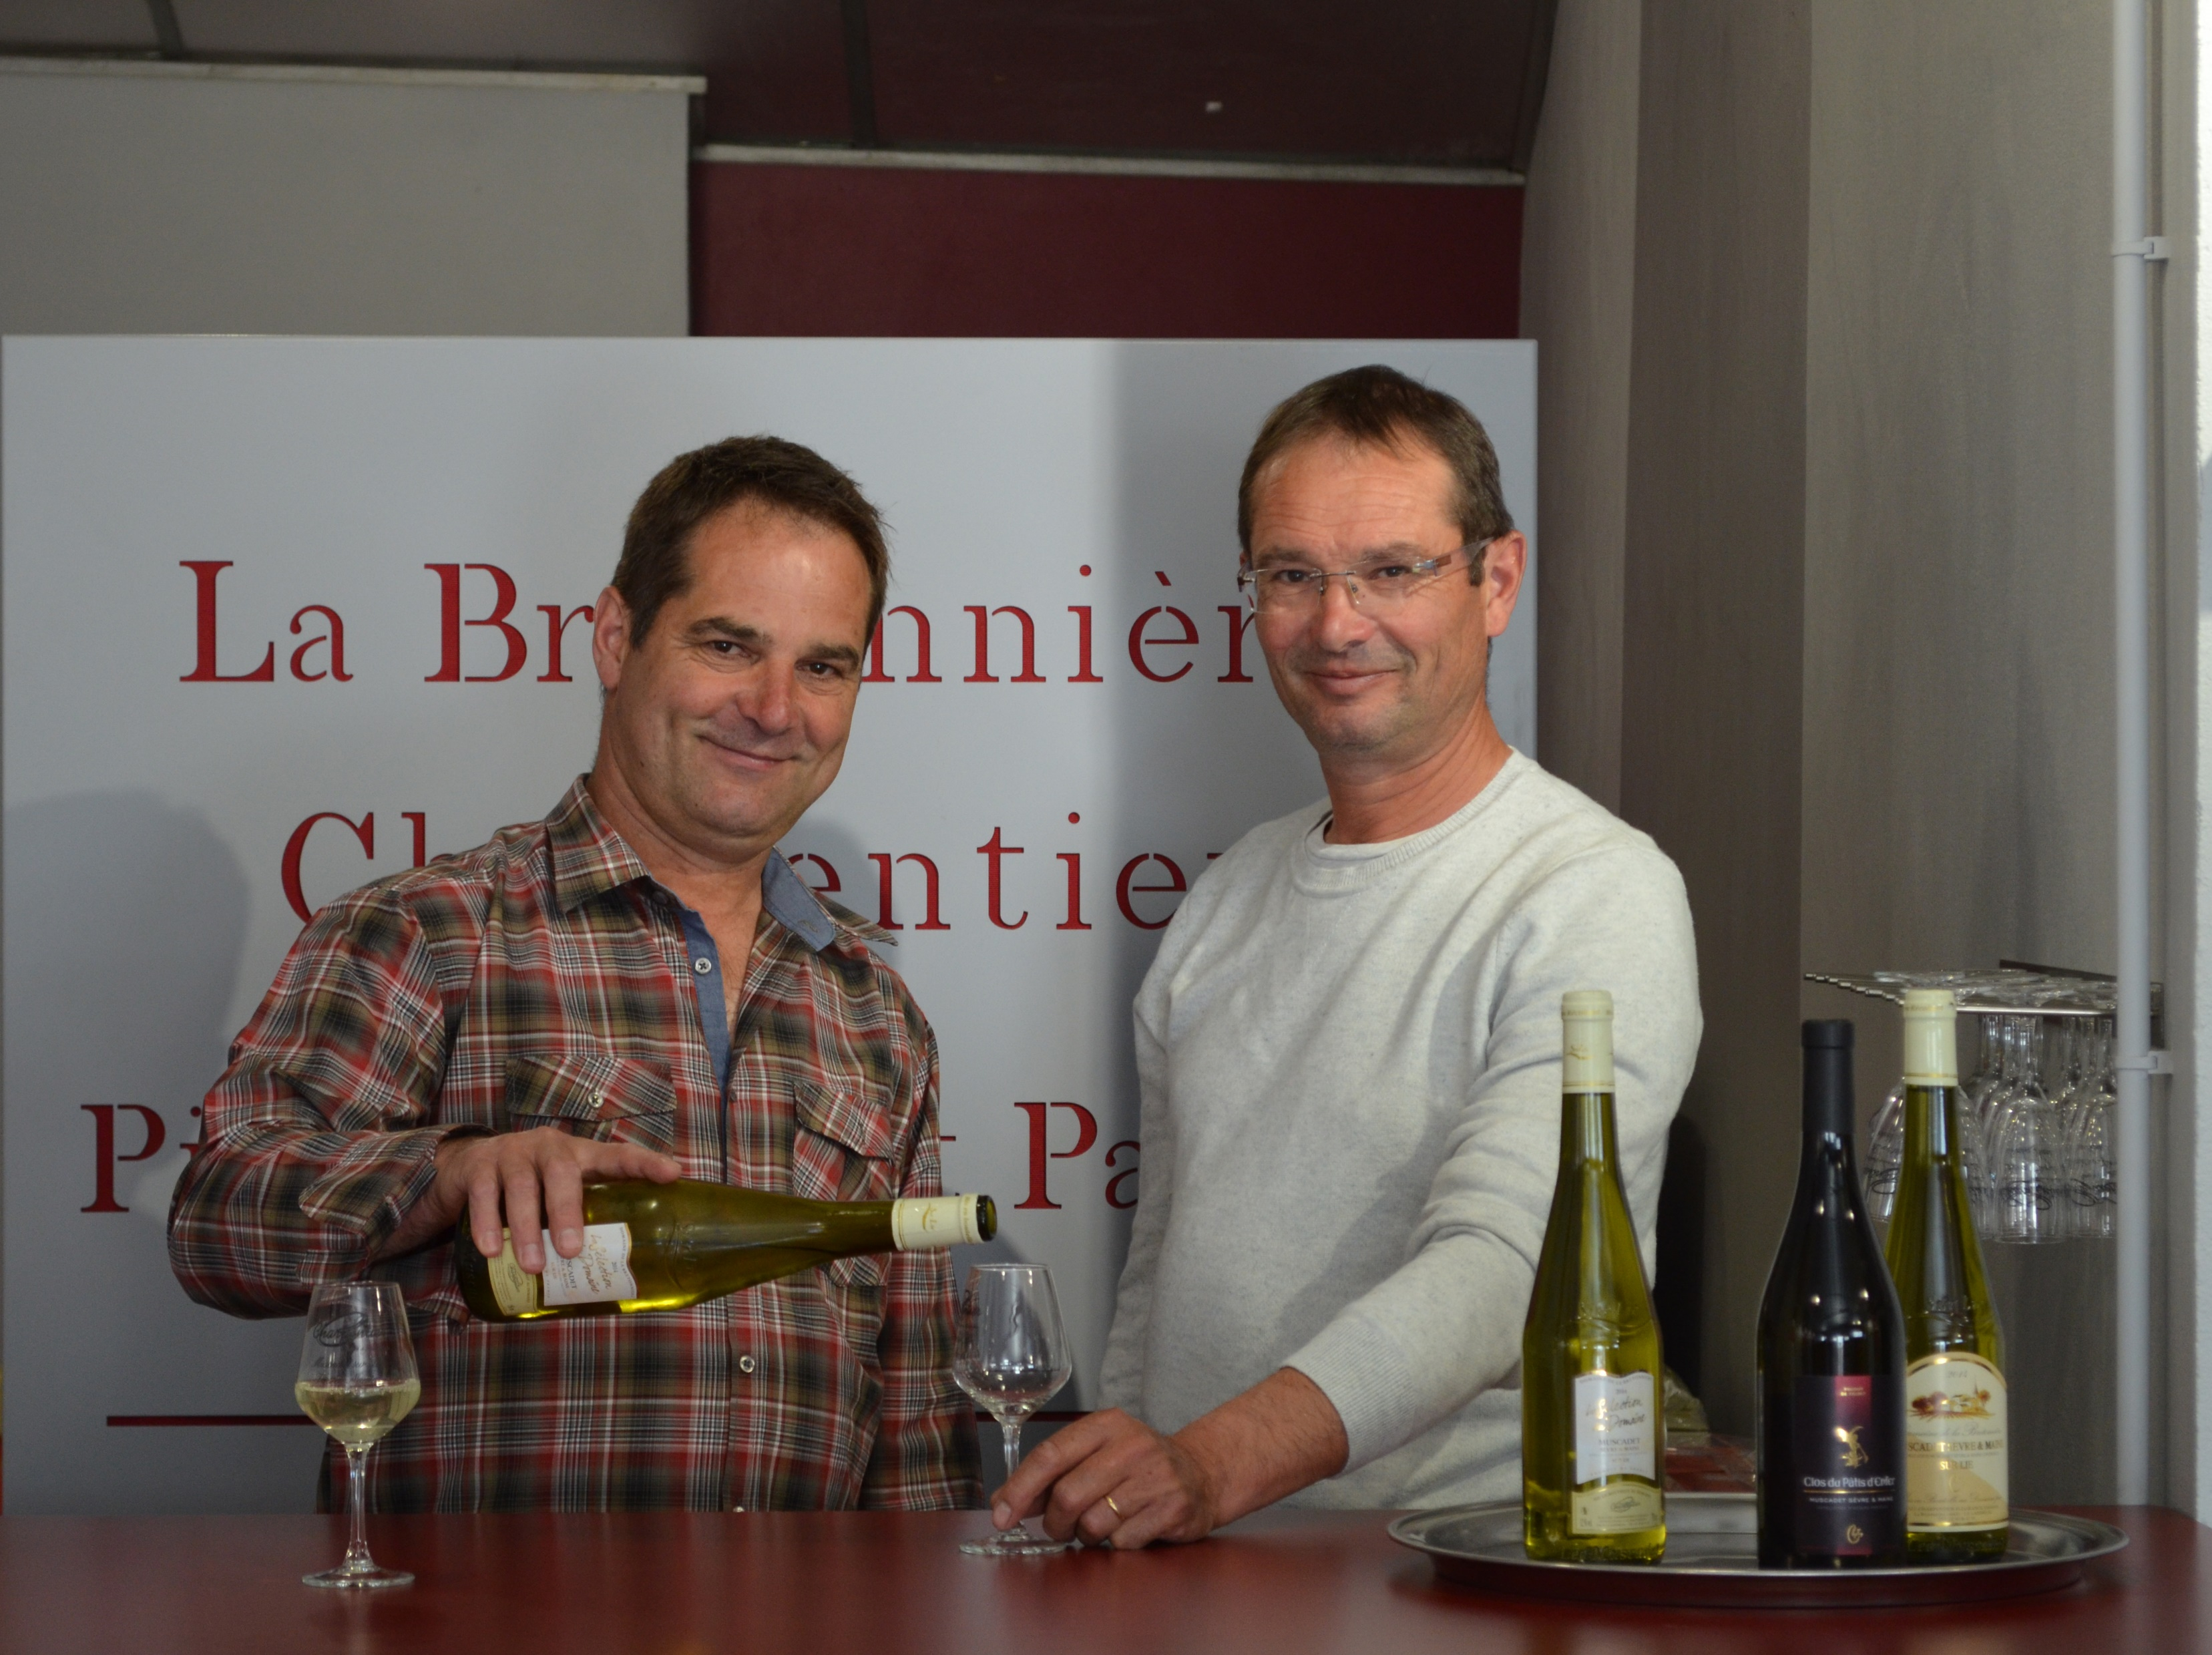
Patrice & Pierre-Yves Charpentier

Slide 10
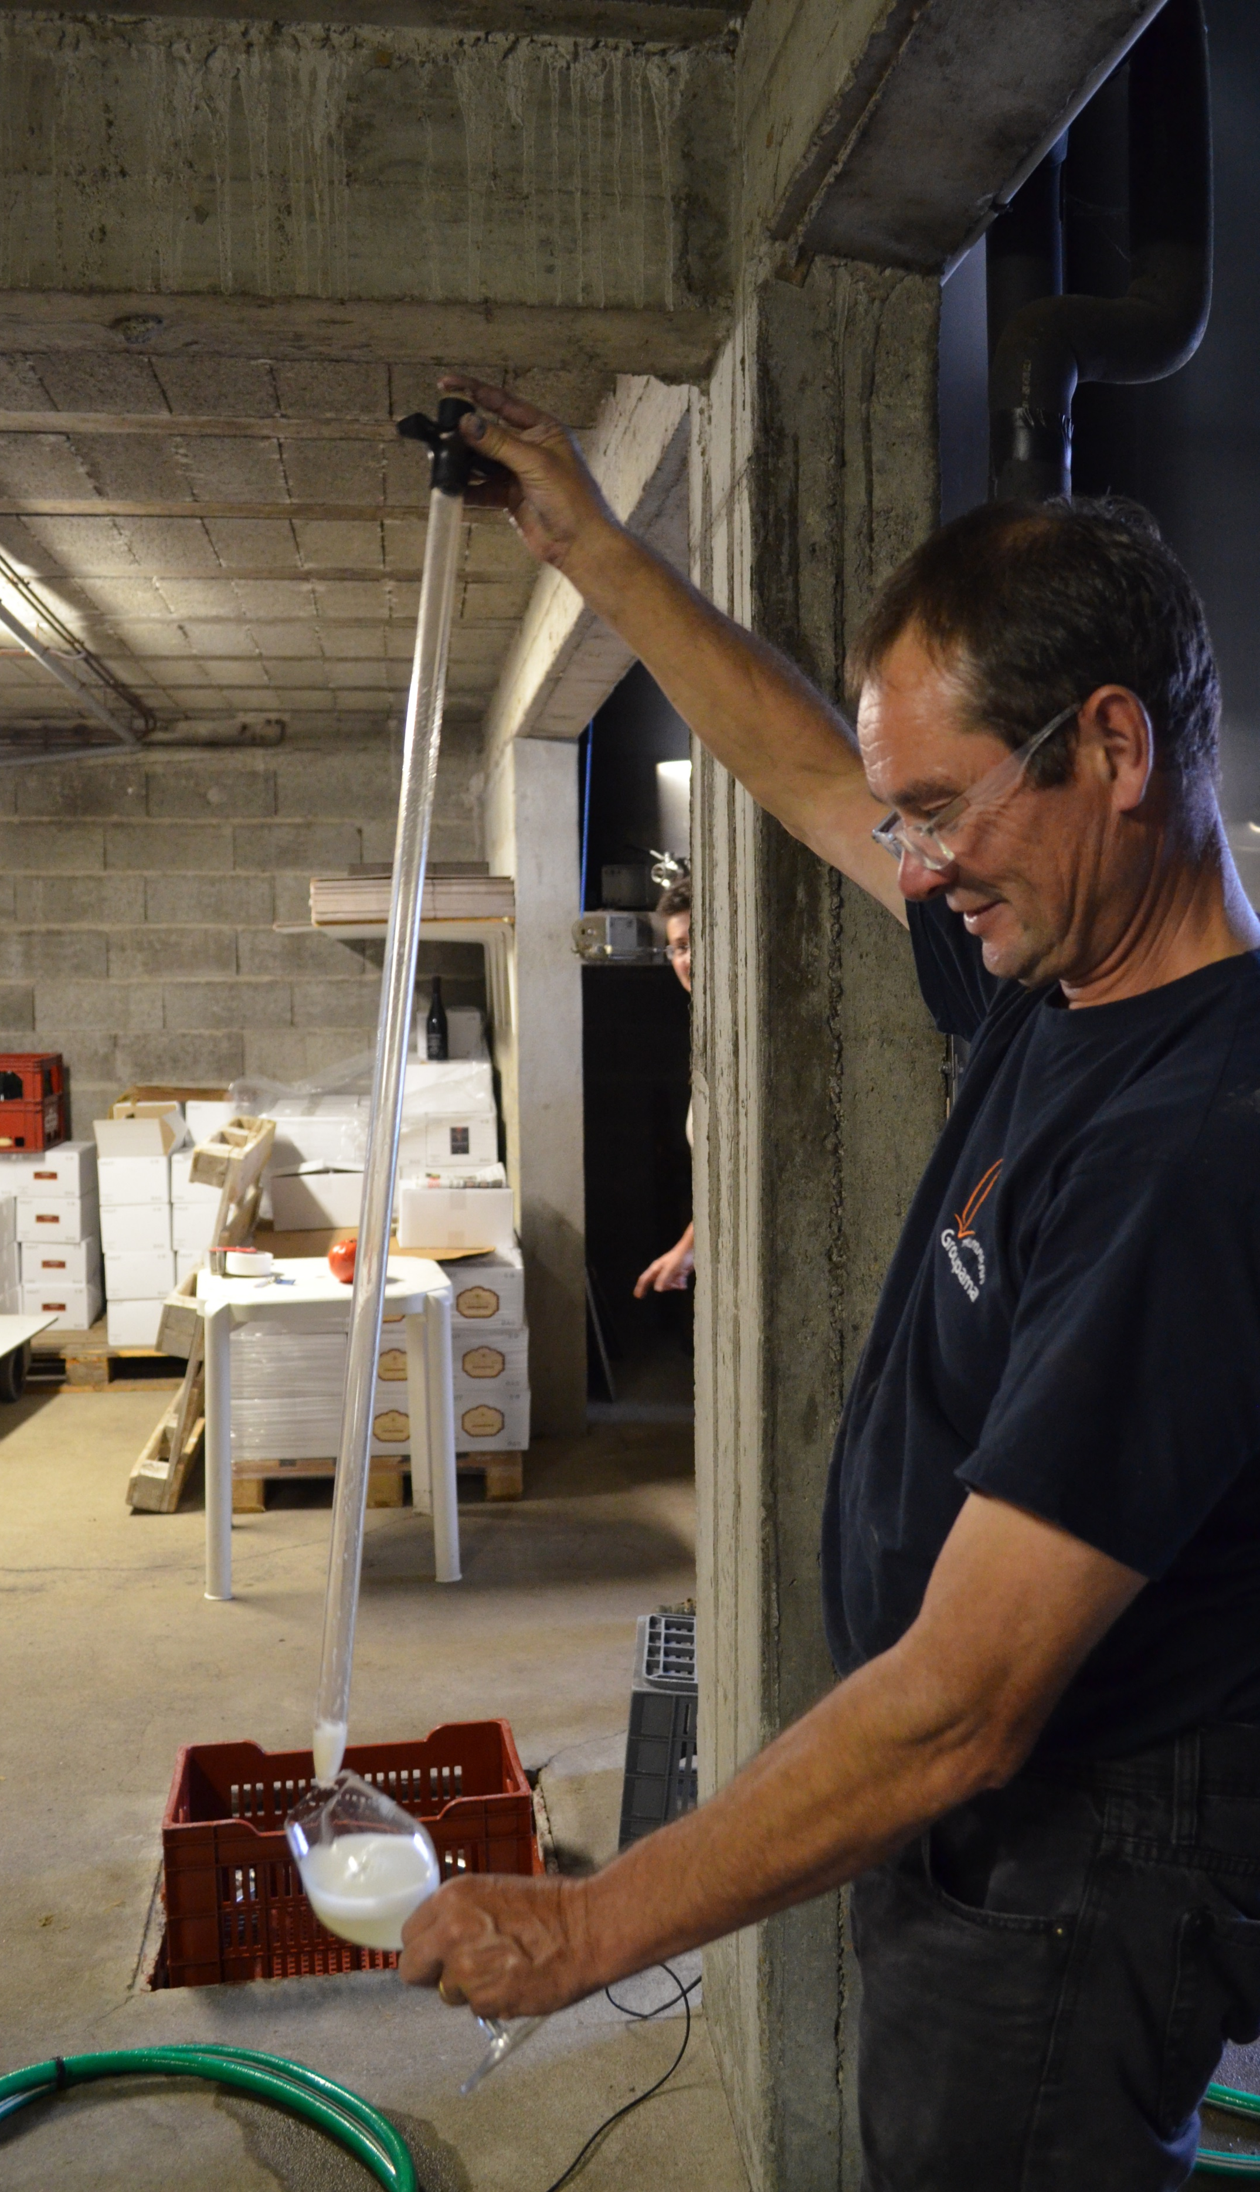
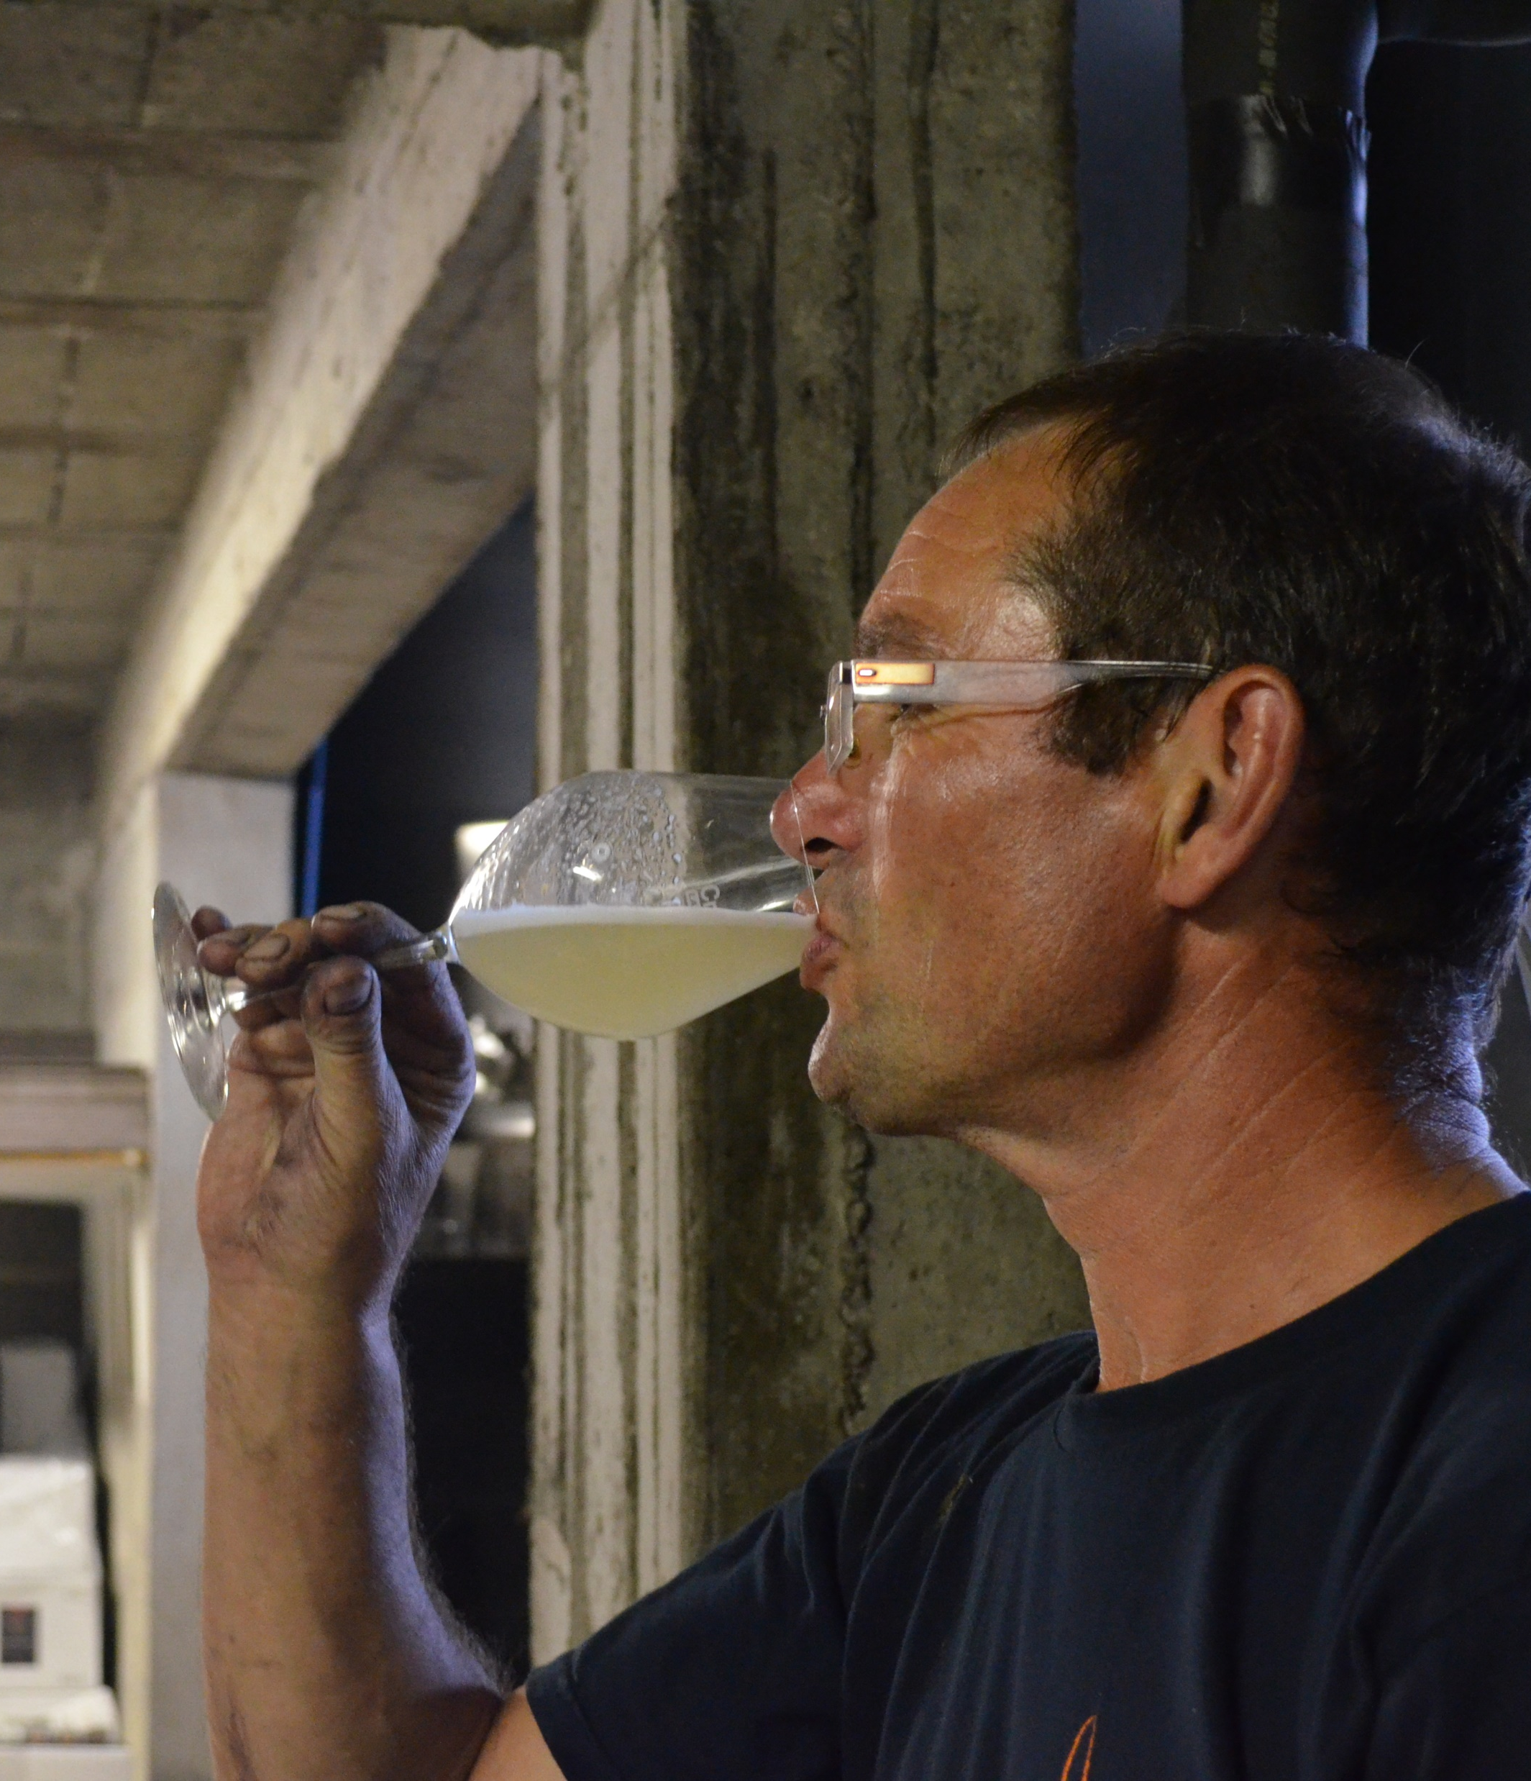
Pierre-Yves
Fourth Generation
Wine Grower

Slide 11
DOMAINE DE LA
BretonniÈre
Muscadet Sevre-et-Maine
100% Melon de Bourgogne
Domaine de La Bretonnière has been in the Charpentier family for four generations, today run by brothers Pierre-Yves and Patrice. 35 year old vines on green gneiss soil over clay. Vinification and elevage is in concrete vats which are buried underground – brief aging on the lees for 6 months before bottling.

